Slide 1
N₂-filled MPC for pulse compression The first/world’s only 3D-UPPE with full capability of Raman-active gases
Yi-Hao Chen

Slide 2
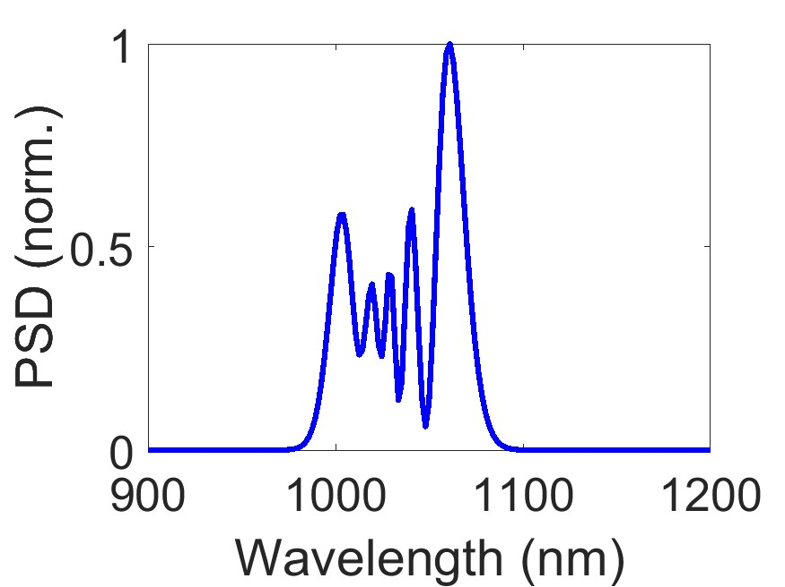
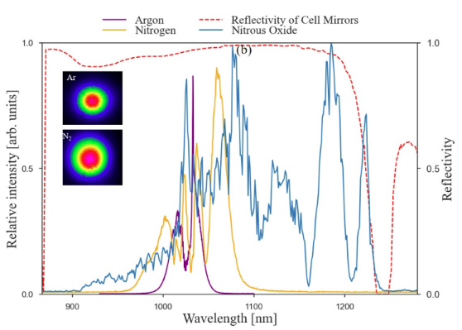
My 3D-simulation vs. paper experiment
Good consistency!
Simulation
Paper experiment (yellow line)

Slide 3
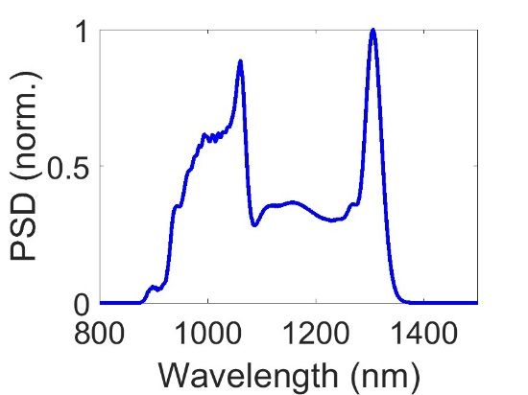
Try to do RA-SESS
Output spectrum
Kinda failed by simply increasing the gas pressure, trying to broaden to 1300 nm. Pulse is set to 140 fs and 40 µJ.
Total MPC propagation length = 34 passes * 26 cm = 8.8 m
The spectrum doesn’t follow RA-SESS.
Possible reasons:
The nonlinearity of each pass becomes too high for MPC, which isn’t a problem in HCF.
We used a short fiber and high pressure in HCF. Need to find its counterpart (if scalable) with a long HCF but lower pressure, which is the case for MPC.
Solution (corresponding to the reasons above):
Increase the number of passes
Find the long-HCF counterpart and duplicate this in the MPC scenario.

Slide 4
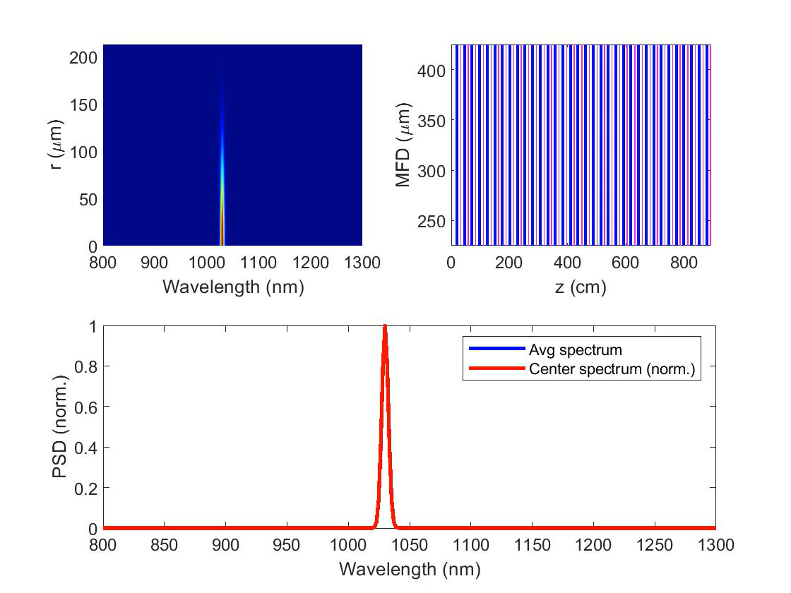
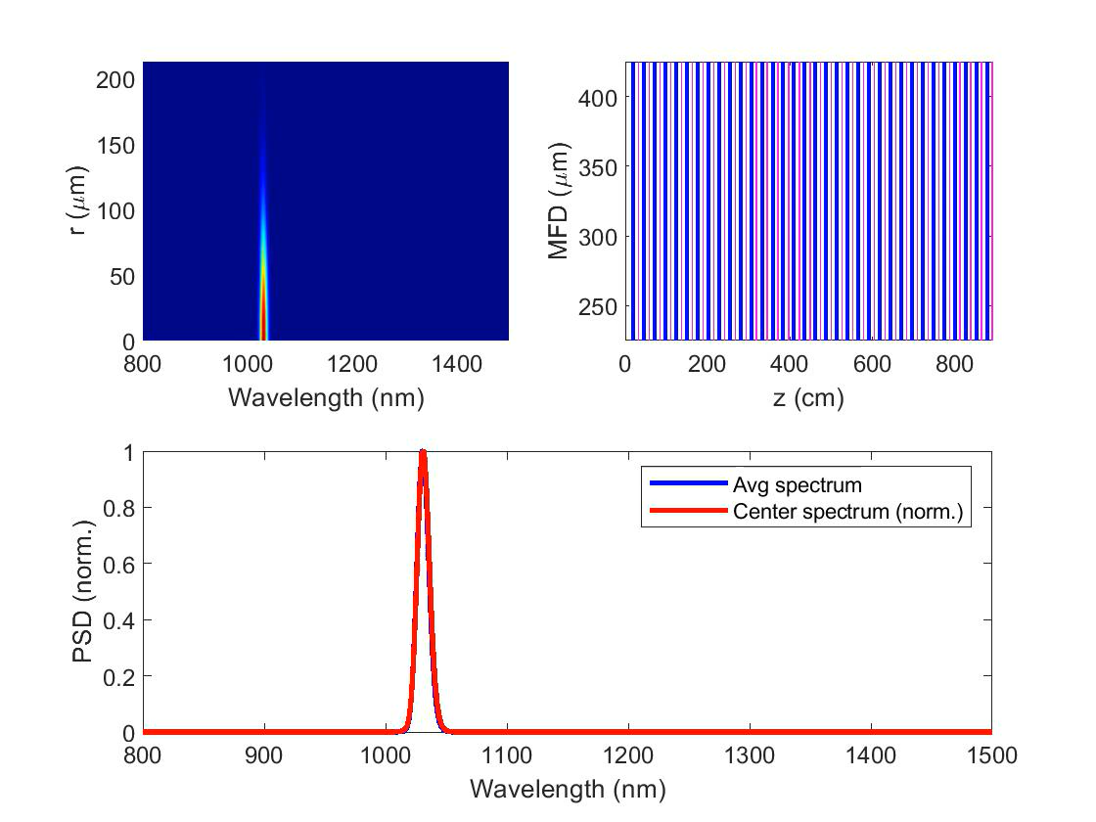
Propagation evolution
Check video:
It initially follows RA-SESS (creating a strong red peak)
N₂ (duplicate paper’s)
N₂ (extend to 1300 nm)

